Slide 1
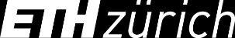

Slide 2
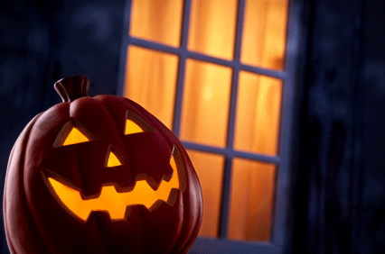





MAS Digital Fabrication
Trick-Or-Treat Submission with Axolotl
Deadline October 29th 2021

Slide 3
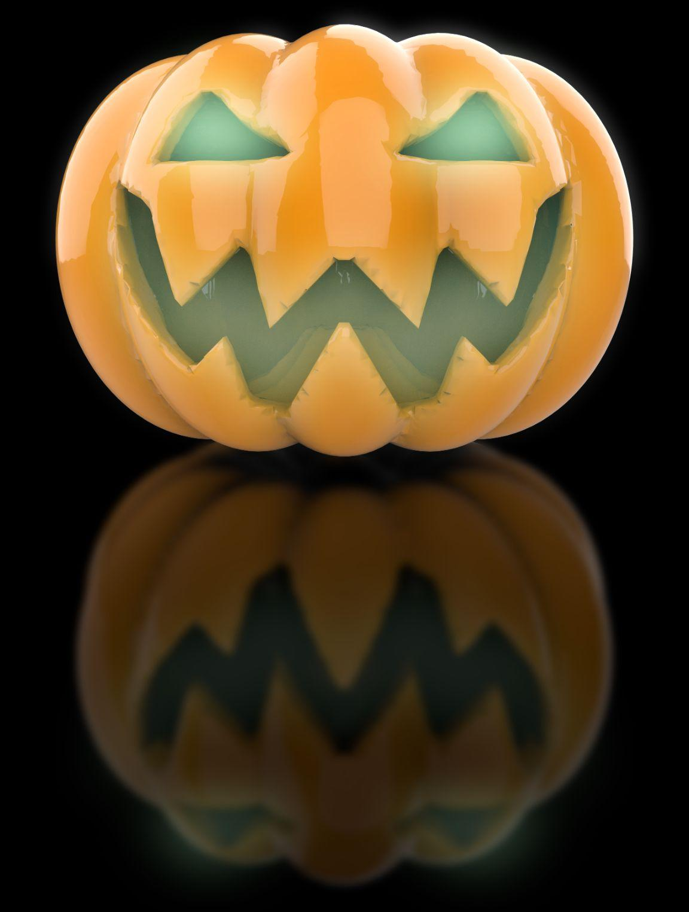
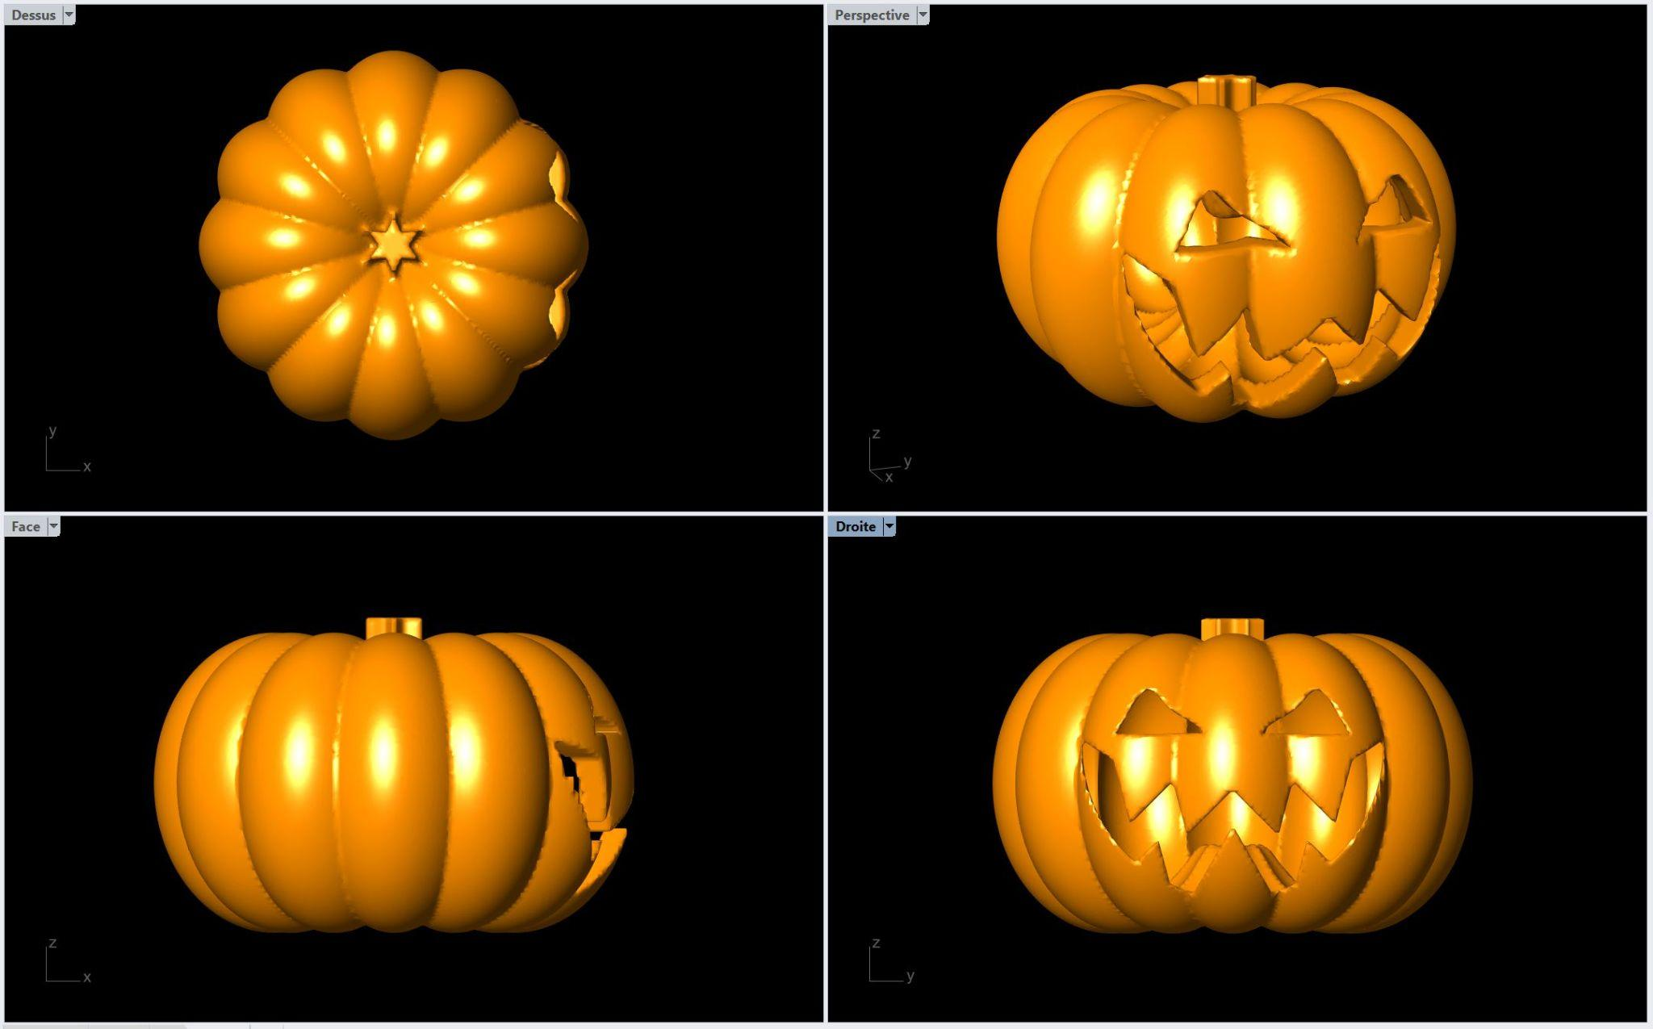
Check your repository to see the definition of this evil pumpkin, exclusively made with Axolotl. Credits: Rémy Clemente

Slide 4
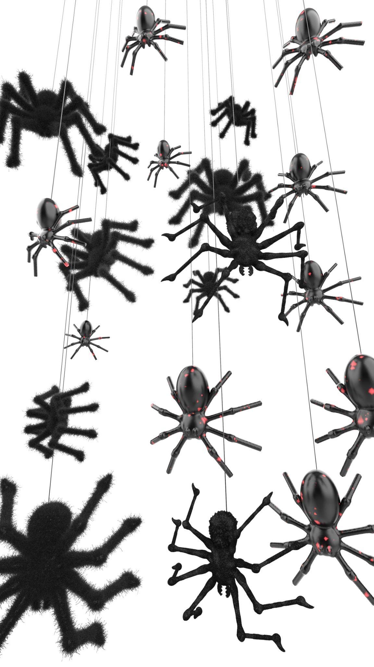
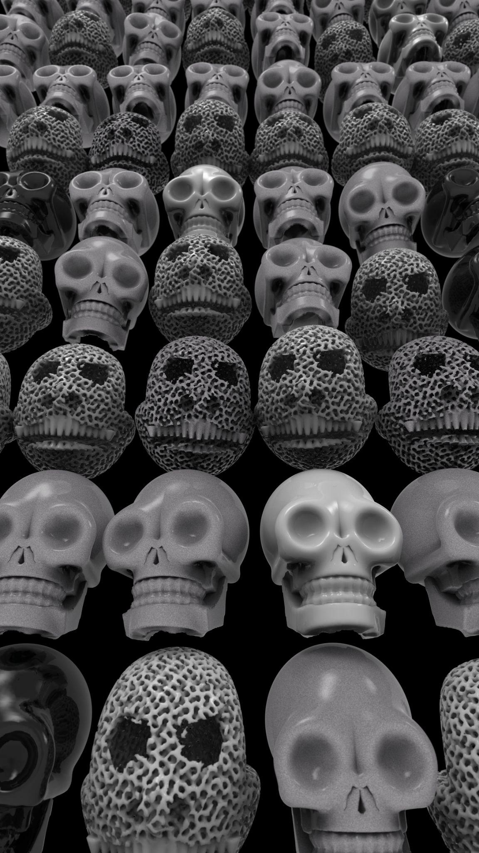
MAS DFAB 2021 - Credits: Wei Chengyuan, Beril Onalan
MAS DFAB 2021 - Credits: Carlos Wilkening, Weiting Chen

Slide 5
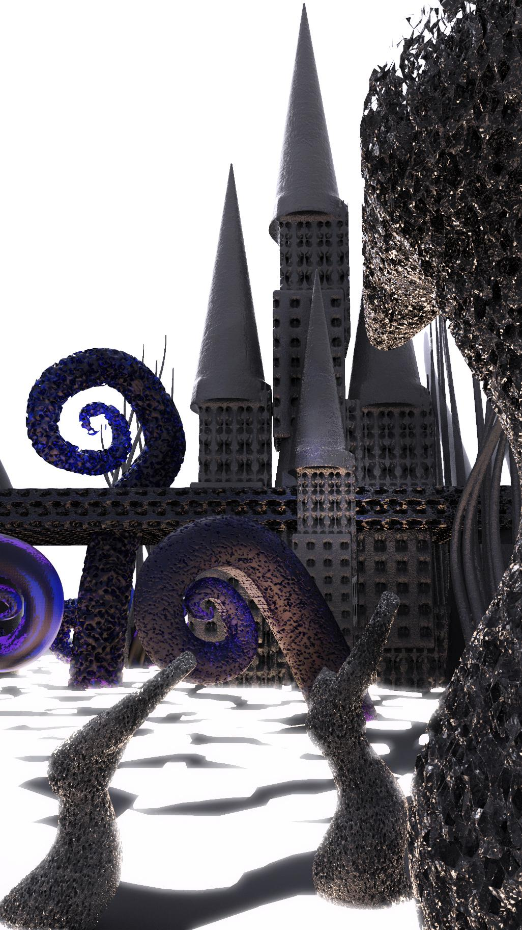
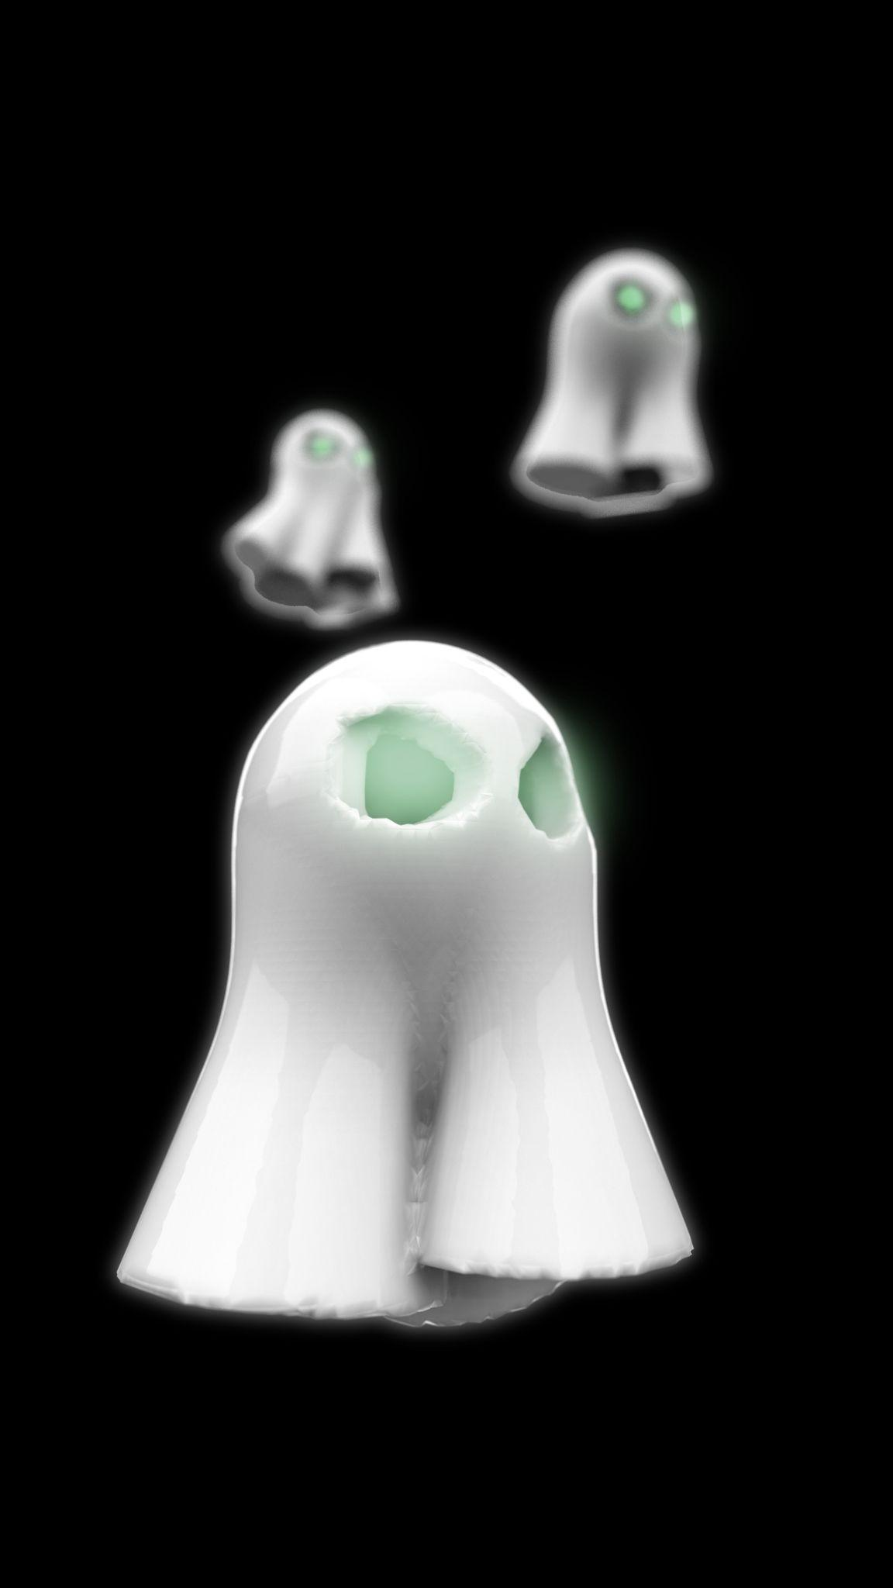
MAS DFAB 2021- Credits: Evgenina Angelaki, Simon Griffioen
MAS DFAB 2021 - Credits: Ilaria Giacomini

Slide 6
SUBMISSION REQUIREMENTS
. Send 3 different visuals of your scary composition using Axolotl -
You will be judge on the qualities of your design and rendering
. Image dimensions : 1080 px wide X 1350 px high
. Give it a name and credit the author(s) -
instagram accounts welcomed
. Avoid violent or offending content
. Submit before October 29th at Midnight

Slide 7
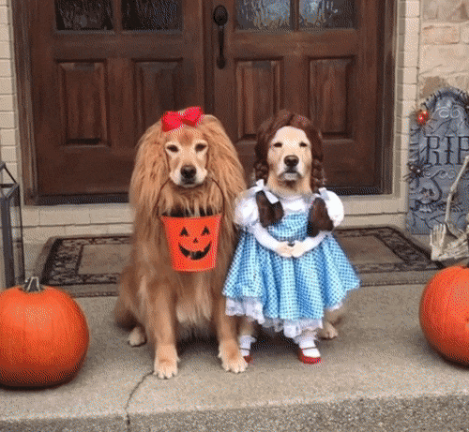
YOU CAN SUBMIT AS GROUPS OF 2 MAX.

Slide 8
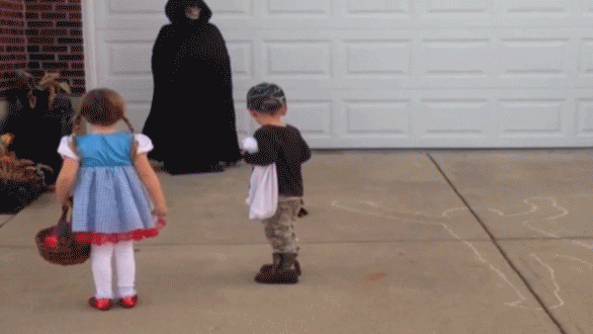
THIS IS NOT COMPULSORY

Slide 9
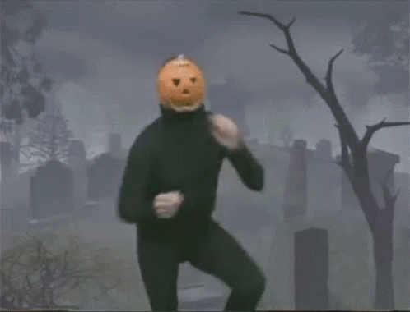
GOOD LUCK AND HAVE FUN!

